Slide 1
IBM University Engagement Project Submission
“Exploring the Power of Agentic AI with IBM Granite and LangFlow”

Slide 2

Project Tile – AI Powered Interview Preparation Platform using IBM watsonx.ai, Granite Models and LangFlow
Domain of Project – Education / Career Development
Student Name | Recent Passport Photo | Email ID | Mobile number [WhatsApp]
SISIRA T S |  | tl23btai0065@vidyaacademy.ac.in | 9995401174

Slide 3
Problem Statement: AI Interview Coach Agent
The Challenge
Students and job seekers often struggle with resume optimization, ATS compatibility, skill gap identification, and interview practice. Existing platforms provide generic questions without considering the candidate's resume, target role, or performance, making interview preparation less effective.
The Objective
Build an AI-powered Interview Coach Agent that provides personalized interview preparation through:
• Resume Analysis & ATS Scoring
• RAG-based retrieval of role-specific interview content
• AI-powered technical and behavioral mock interviews
• Personalized learning roadmap with recommended resources
• Multi-Agent System
Resume Analysis Agent
Career Match Agent
Interview Coach Agent
Evaluation Agent
Learning Plan Agent
• Analytics dashboard for ATS score, readiness, skill gaps, and progress tracking.

Slide 4
Proposed Solution: AI-Powered Interview Coach Agent
The proposed solution is a multi-agent AI-powered Interview Coach Agent built using LangFlow, IBM watsonx.ai, IBM Granite Models, and RAG to provide personalized interview preparation.
The system uses a RAG pipeline to retrieve interview questions, company information, and learning resources from trusted knowledge sources through a vector database.
The system consists of five key agents:
Resume Analysis Agent – Analyzes resumes and calculates ATS score.
Career Match Agent – Matches skills with job requirements.
Interview Coach Agent – Generates personalized technical and HR interview questions.
Evaluation Agent – Evaluates answers and provides feedback.
Learning Plan Agent – Recommends personalized learning roadmaps.
The solution includes an interactive dashboard to track ATS score, interview performance, skill gaps, and learning progress.
LangFlow manages the agent workflow, while IBM watsonx.ai and Granite Models power reasoning, evaluation, and personalized recommendations.
Overall, the solution provides an intelligent interview preparation platform that improves confidence and placement readiness.

Slide 5
Technology Used
LangFlow Platform – For designing and orchestrating the multi-agent interview workflow visually.
IBM Granite 4 Model (ibm/granite-4-h-small) – For resume analysis, interview question generation, answer evaluation, and personalized feedback.
IBM watsonx.ai – For deploying Granite models, prompt execution, inference, and AI governance.
RAG (Retrieval-Augmented Generation) – Retrieves interview questions, company-specific knowledge, and learning resources before generating responses.
Vector Database (FAISS) – Stores document embeddings and enables fast RAG-based retrieval from the interview knowledge base.
Flask Framework – Provides the backend APIs, session management, and web application functionality.

Slide 6
Langflow component Used
1) Chat Input – Interface where users upload resumes, enter interview queries, or select target job roles.
2) IBM watsonx AI Agent – Processes user requests using IBM Granite models to generate interview questions, evaluate answers, and provide personalized guidance.
3) IBM Granite Model – Granite-4.1-8B-Instruct → Used for resume analysis, interview question generation, response evaluation, and career recommendations.
4) Chat Output – Displays AI-generated interview questions, evaluation scores, ATS analysis, feedback, and learning plans.
5) File Component – Stores and retrieves resumes, interview knowledge documents, and learning resources for RAG-based retrieval.
6) FAISS Vector Store (Retriever) – Stores embeddings of resumes and interview knowledge, enabling fast and accurate Retrieval-Augmented Generation (RAG).

Slide 7
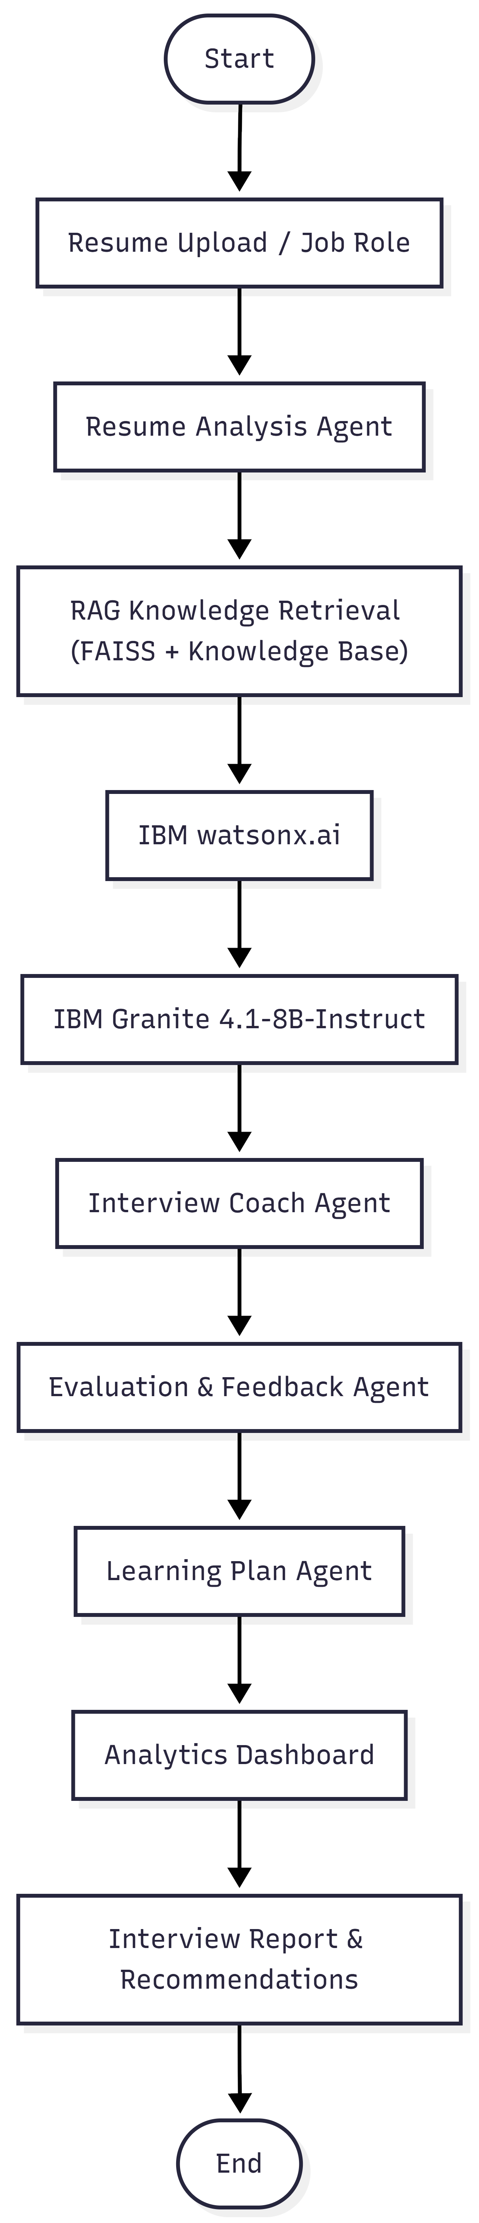
Workflow of AI Interview Trainer Agent

Slide 8
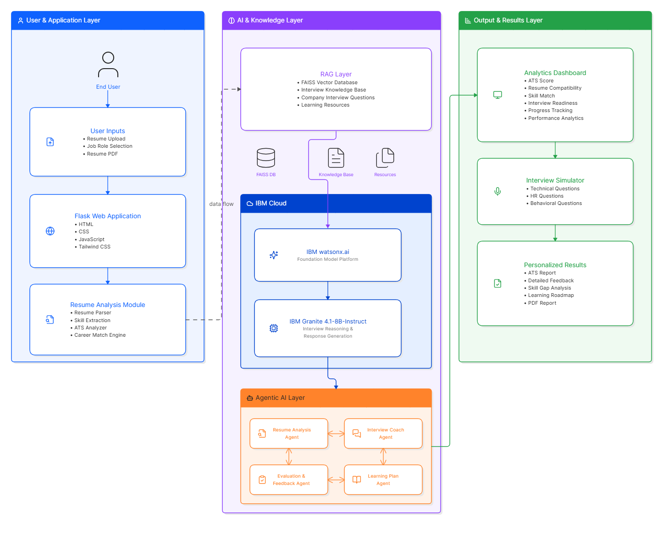
Architecture blueprint

Slide 9
Role of Agentic AI in the solution
Role of Agentic AI in Interview Coach Agent
Agentic AI enables the Interview Coach Agent to function as an intelligent, autonomous system rather than a simple chatbot. Using IBM watsonx.ai and IBM Granite models, it coordinates multiple specialized agents to deliver personalized interview preparation and career guidance.
Each agent performs a specific role, such as analyzing resumes, matching candidate skills with job requirements, generating interview questions, evaluating responses, and creating personalized learning plans. This multi-agent approach ensures efficient task execution and accurate results.
Agentic AI also provides context awareness by understanding the candidate's resume, target job role, experience, and skill level to generate tailored recommendations. It continuously adapts interview questions and learning plans based on user performance and feedback.
Additionally, agents collaborate with each other to improve decision-making and provide a complete interview preparation experience.
Overall, Agentic AI makes the system proactive, personalized, and goal-driven, acting as an intelligent AI interview coach that helps users improve confidence, develop skills, and increase placement readiness.

Slide 10
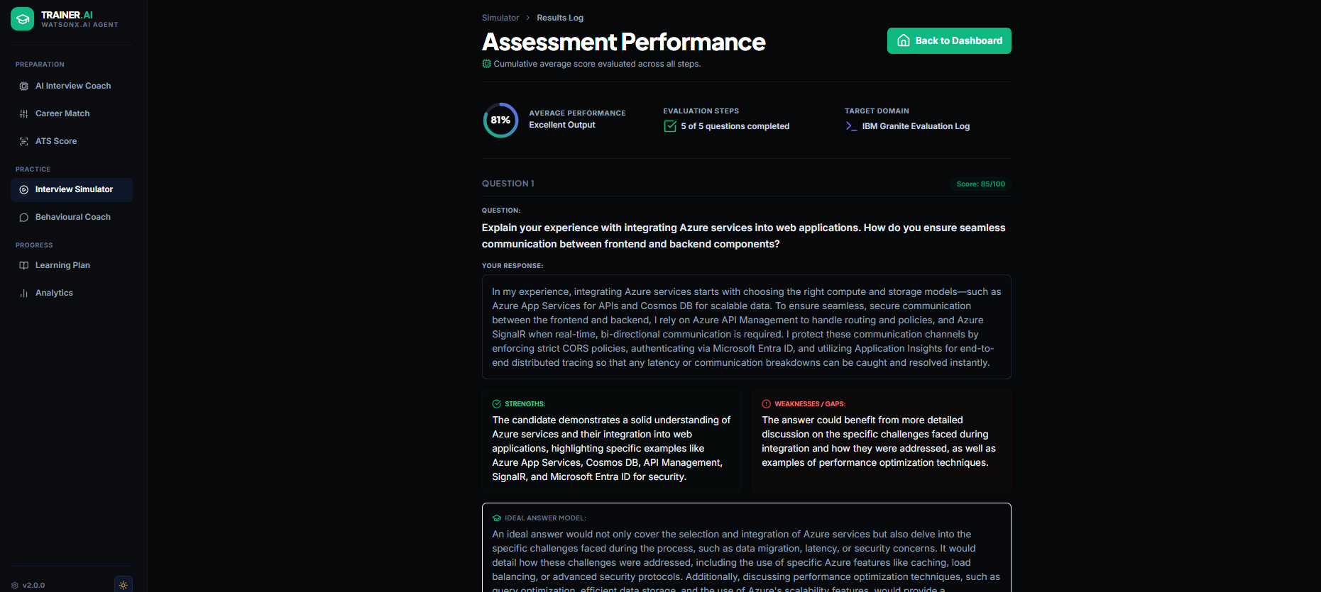
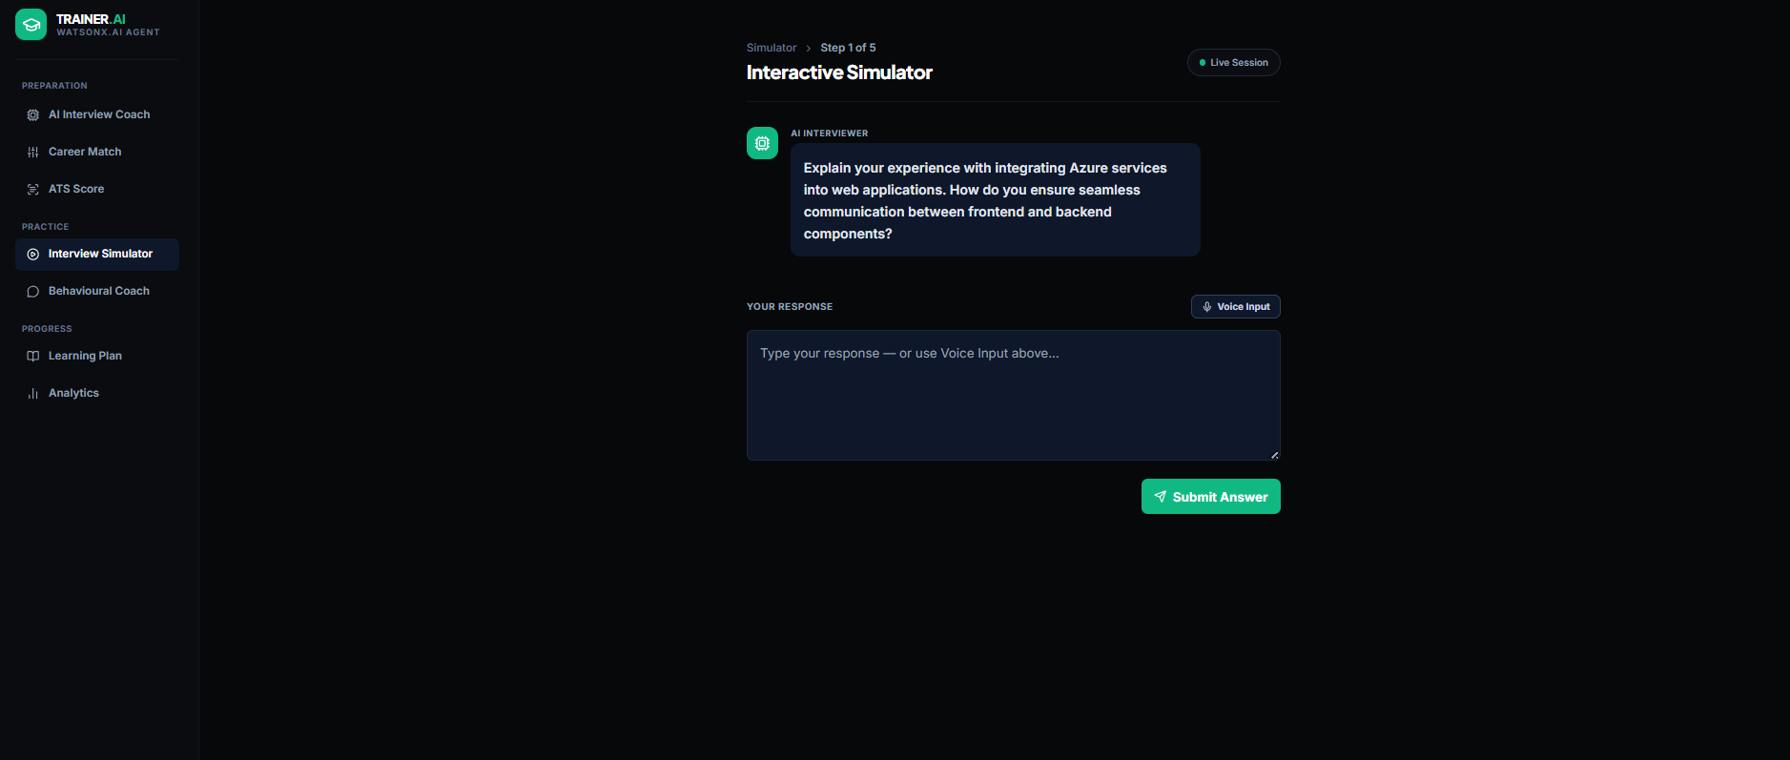
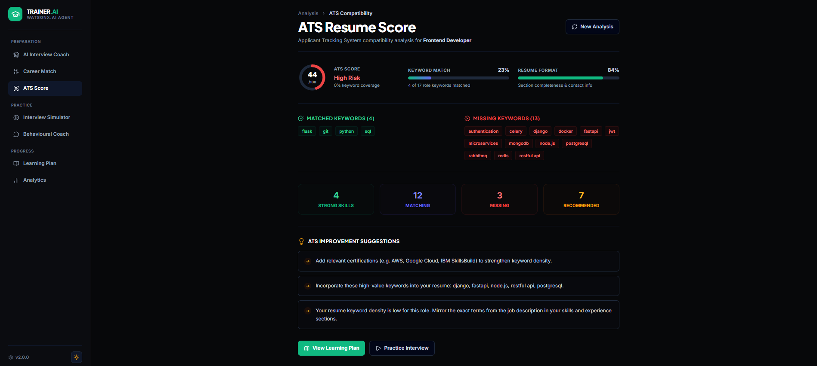
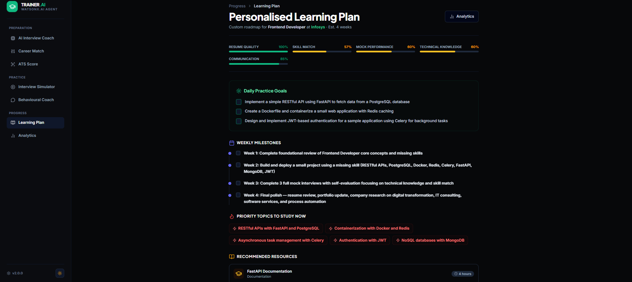
IBM Granite AI Prompt Execution & Results
·
·
·

Slide 11
Novelty and Uniqueness
The proposed Interview Coach Agent stands out by combining Agentic AI, RAG, and personalized interview preparation into a single intelligent platform.
Multi-Agent Intelligence – Specialized agents collaborate for resume analysis, interview generation, evaluation, and learning guidance.
RAG-Based Accuracy – Retrieves role-specific interview questions and learning resources before generating AI responses.
Personalized Interview Preparation – Adapts questions, feedback, and learning plans based on the candidate's resume, skills, and target job role.
Real-Time Performance Evaluation – Instantly analyzes responses and provides scores with improvement suggestions.
ATS Resume Analysis – Evaluates resume compatibility and recommends optimizations for better recruitment success.
Interactive Analytics Dashboard – Tracks ATS score, interview readiness, skill gaps, and learning progress.
Scalable & Enterprise-Ready – Built using IBM watsonx.ai, IBM Granite Models, and LangFlow for reliable, secure, and scalable AI deployment.
This makes the solution an intelligent, adaptive, and proactive AI interview coach, rather than a traditional interview practice platform.

Slide 12
Scalability & Deployment Readiness
The application is containerized using Docker and deployed on Google Cloud Run for reliable and scalable cloud execution.
Its modular multi-agent architecture and RAG with FAISS enable easy expansion with new features and knowledge sources.
IBM watsonx.ai and IBM Granite provide secure, production-ready AI services for personalized interview preparation.
The application is publicly accessible through a live deployment and uses secure environment variables for configuration.
Live Demo
https://interviewtraineragent-174815016344.asia-south1.run.app/

Slide 13
Commercial & Market Viability
The platform addresses the growing demand for AI-powered interview preparation and career guidance.
It can be adopted by students, colleges, placement cells, training institutes, and recruitment organizations.
The solution can be offered as a subscription-based platform or licensed to educational institutions and enterprises.
Its modular architecture allows easy integration with existing learning management and recruitment systems.
cloud deployment and scalable AI services, the platform is ready for real-world adoption and future expansion.

Slide 14
Contribution to Society
The platform improves employability by helping students and job seekers prepare for interviews with personalized AI guidance.
It provides affordable and accessible interview coaching, reducing the need for expensive training programs.
Skill gap analysis and learning recommendations encourage continuous learning and career development.
The solution supports educational institutions and placement cells in improving student placement outcomes.
By making quality interview preparation accessible to everyone, it helps create equal career opportunities.

Slide 15
Git Hub Link
Repository Name: InterviewTrainerAgent
Repository URL:
https://github.com/sisirats005-ux/InterviewTrainerAgent
·
·
·

Slide 16
Future Scope
AI Voice Interview & Video Assessment The system can be enhanced with AI-powered voice and video interviews to evaluate communication skills, confidence, pronunciation, facial expressions, and body language. This will provide users with a realistic interview experience and more comprehensive performance feedback.
Company-Specific Interview Preparation & Career Guidance The platform can be expanded to support company-specific interview preparation for organizations such as IBM, Google, Microsoft, and Amazon. It can also recommend personalized learning resources, certification paths, and career roadmaps based on the user's skills, target role, and interview performance.
·
·
·

Slide 17
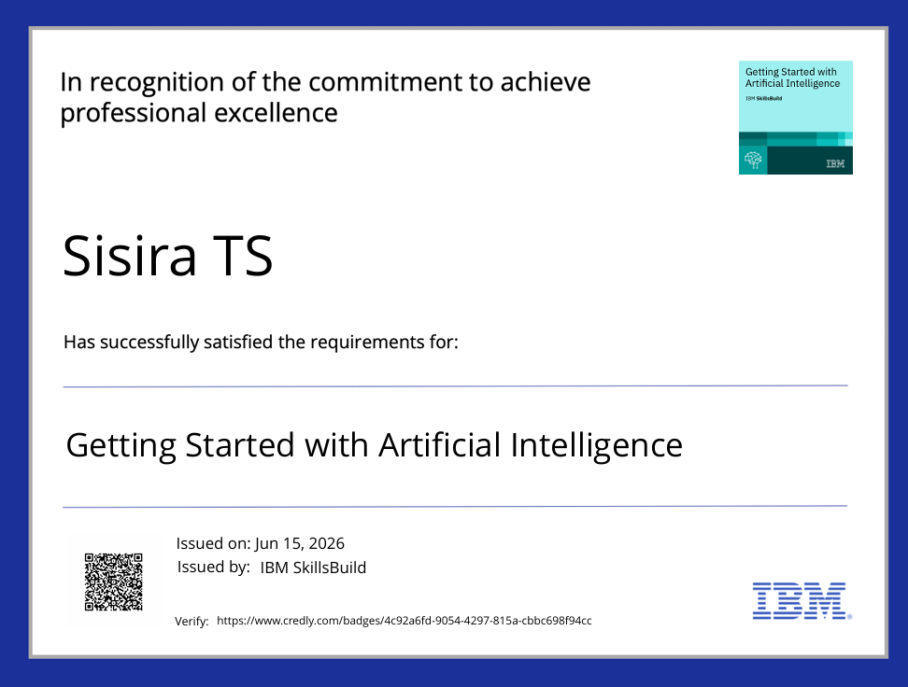
Certificates Earned:
Please add your credly certificate

Slide 18
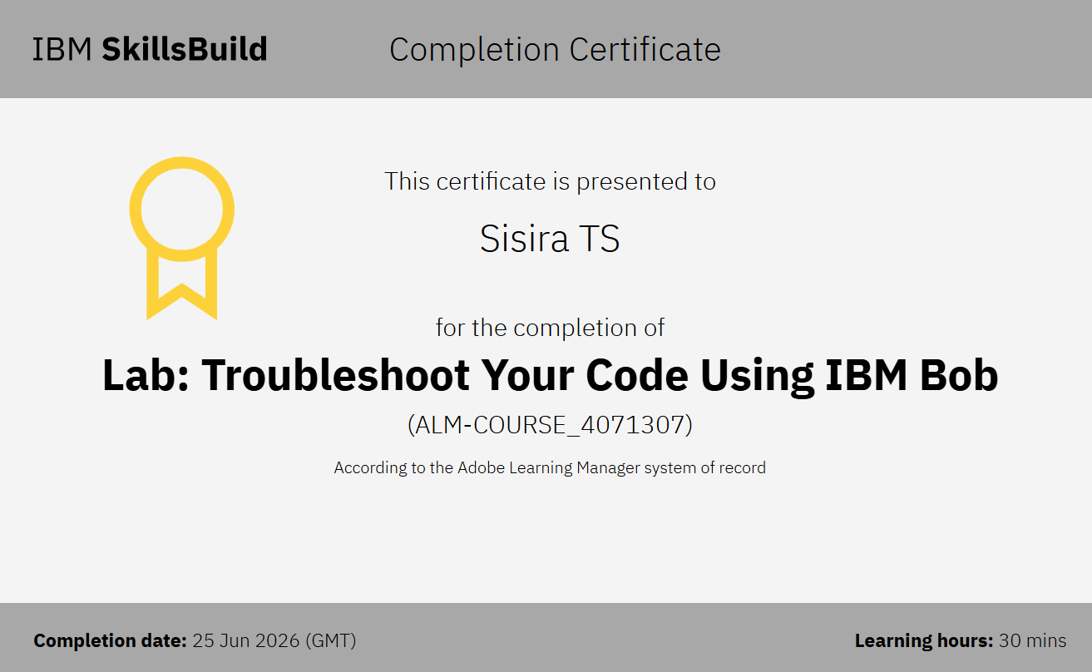
Certificates Earned:​
Add your IBM BOB Certificate

Slide 19


